Slide 1
Session 10 Topics
Checking Assumptions with Residual Plots
Overall ANOVA test in Regression using sums of squares
Regression Confidence Intervals

Slide 2
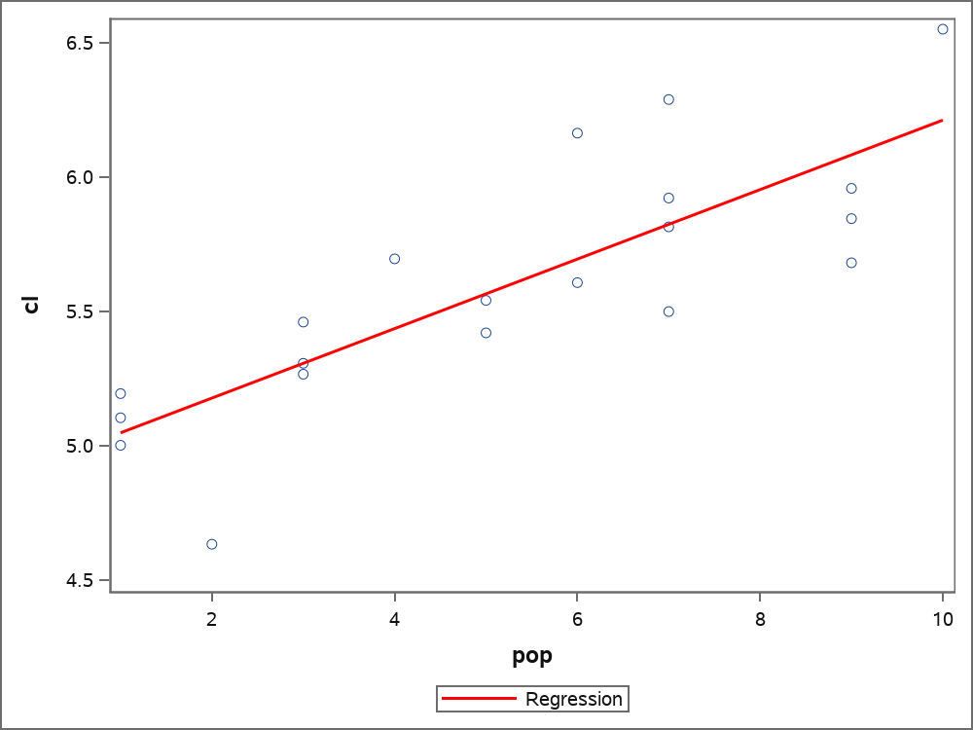
Example: Construct a model for a telecom company to predict call length based on a county's population
Model
CL_{i} = pop_{i}β₁ + β₀ + ε_{i}
Y_{i} = x_{i} β₁ + β₀ + ε_{i}
Sample size n = 20

Slide 3
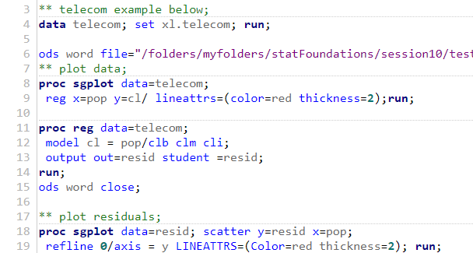
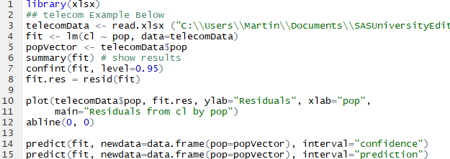
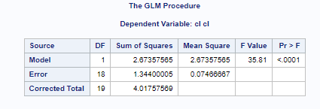
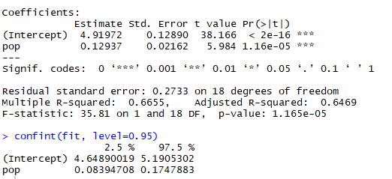

Example: Code and Model Output
SAS
R

Slide 4
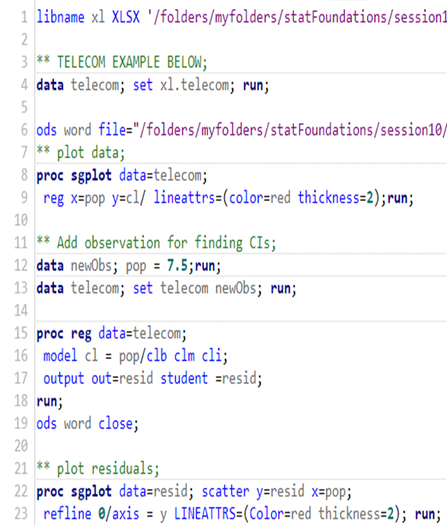
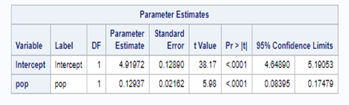
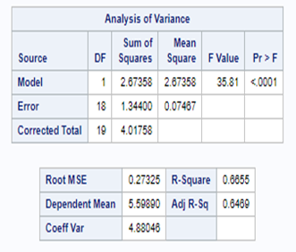
Example: Code and Model Output SAS
You will do this for Live Assignment and Homework.

Slide 5
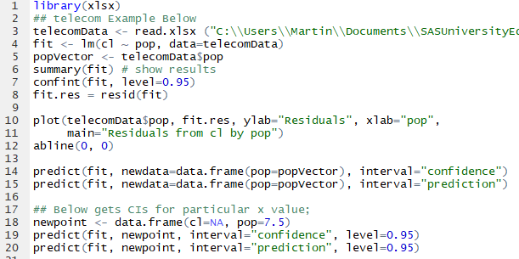
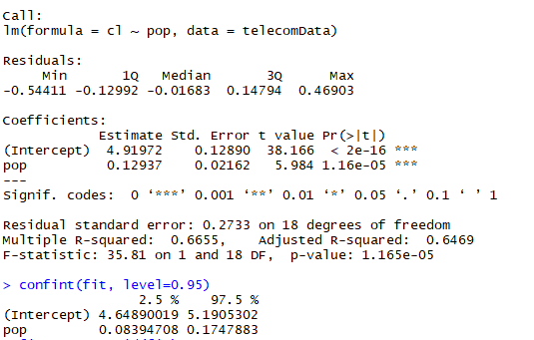
Example: Code and Model Output R
You will do this for Live Assignment and Homework

Slide 6
Example: Confidence Intervals
SAS
R

Slide 7
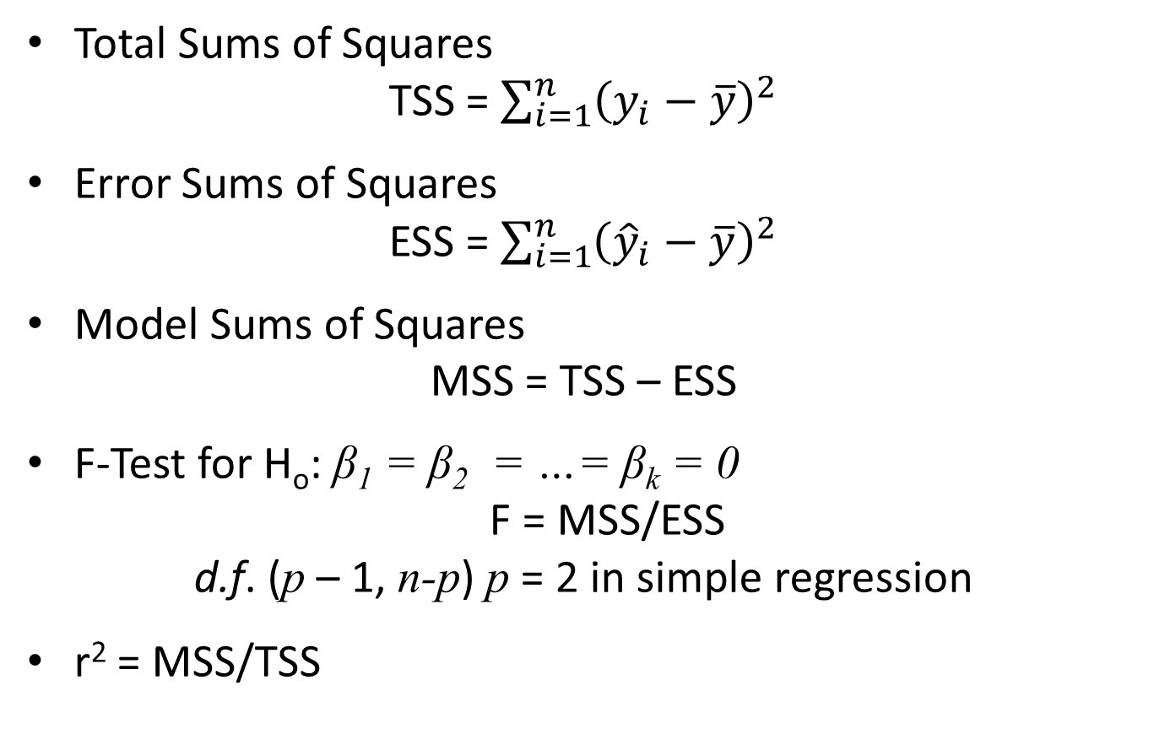
ANOVA and Regression
Total Sums of Squares
TSS = $\sum_{i=1}^{n}{{\left(y_{i}−\overline{y}\right)}^{2}}$
Error Sums of Squares
ESS = $\sum_{i=1}^{n}{{\left({\hat{y}}_{i}−\overline{y}\right)}^{2}}$
Model Sums of Squares
MSS = TSS – ESS
F-Test for H_{o}: β₁ = β₂ = …= β_{k} = 0
F = MSS/ESS
d.f. (p – 1, n-p) p = 2 in simple regression
r² = MSS/TSS

Slide 8
Regression Confidence Intervals
Confidence intervals for the mean of dependent variable (ȳ_{i}|x_{i})
Confidence intervals for prediction of a particular value of the dependent variable (y_{i}|x_{i})
Calibration confidence Intervals for (x_{i}|y_{i})

Slide 9
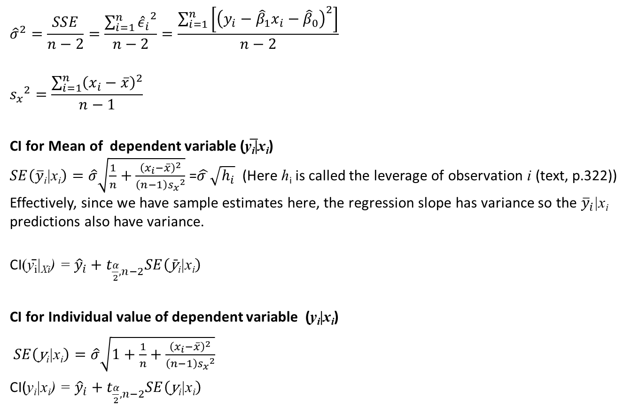
Formulas for confidence intervals Mean of dependent variable (ȳ_{i}|x_{i}) Individual value of dependent variable (y_{i}|x_{i})
$${\hat{σ}}^{2}=\frac{SSE}{n−2}=\frac{\sum_{i=1}^{n}{{{\hat{ε}}_{i}}^{2}}}{n−2}=\frac{\sum_{i=1}^{n}{\left[{\left(y_{i}−{\hat{β}}_{1}x_{i}−{\hat{β}}_{0}\right)}^{2}\right]}}{n−2}$$
$${s_{x}}^{2}=\frac{\sum_{i=1}^{n}{{\left(x_{i}−\overline{x}\right)}^{2}}}{n−1}$$
CI for Mean of dependent variable (y̅_{i}|x_{i}) $SE\left(\overline{y}\text{i}\text{|}\text{x}\text{i}\right)=\hat{σ}\sqrt{\frac{1}{n}+\frac{{\left(x_{i}−\overline{x}\right)}^{2}}{\left(n−1\right){s_{x}}^{2}}}$ =$\hat{σ }\sqrt{h_{i}}$ (Here h_{i} is called the leverage of observation i (text, p.322))
Effectively, since we have sample estimates here, the regression slope has variance so the ${\overline{y}}_{i}\text{|}\text{x}\text{i}$ predictions also have variance.
CI(ȳ_{i}|_{Xi}) = ${{\hat{y}}_{i}+t}_{\frac{α}{2},n−2}SE\left(\text{y}̄\text{i}\text{|}\text{x}\text{i}\right)$
CI for Individual value of dependent variable (y_{i}|x_{i})
$SE\left(\text{y}\text{i}\text{|}\text{x}\text{i}\right)=\hat{σ}\sqrt{1+\frac{1}{n}+\frac{{\left(x_{i}−\overline{x}\right)}^{2}}{\left(n−1\right){s_{x}}^{2}}}$
CI(y_{i}|x_{i}) = ${{\hat{y}}_{i}+t}_{\frac{α}{2},n−2}SE\left(\text{y}\text{i}\text{|}\text{x}\text{i}\right)$

Slide 10
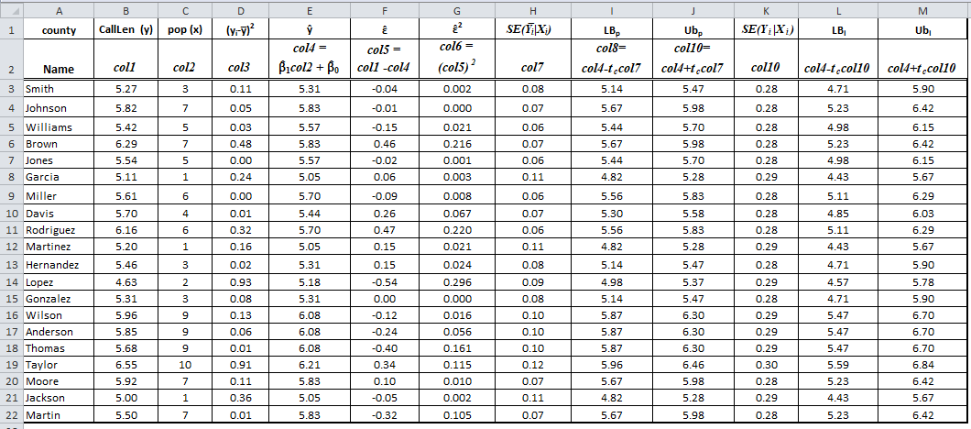
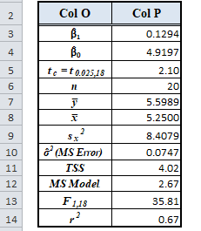
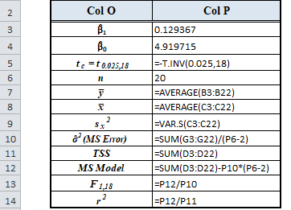
Example: Calculations Regression
Note: In col7 and col10, the values are predictions derived from a model with all the data less the observation for which the SE is being calculated.

Slide 11
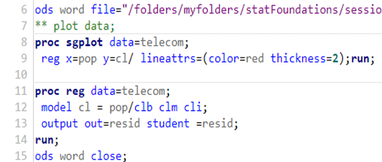
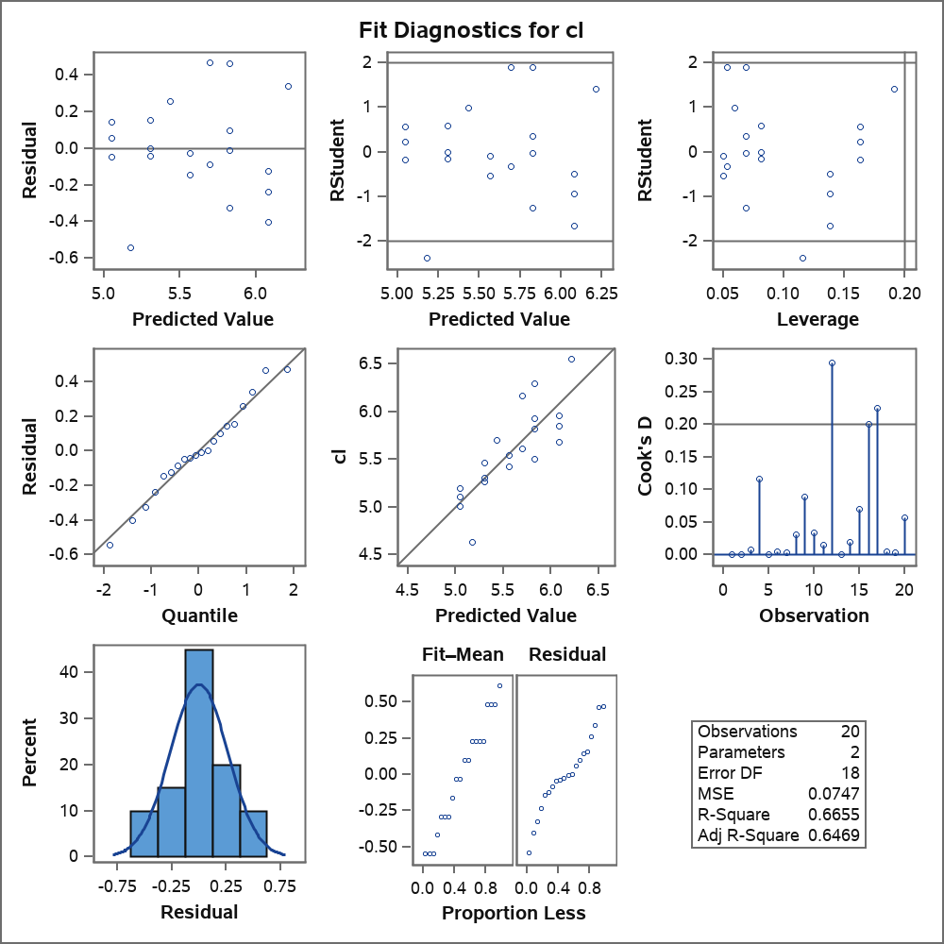

Regression: Checking Assumptions Using Graphics Linearity, Normality of Error Terms Constant Error Variance, Independent Obs.

Slide 12
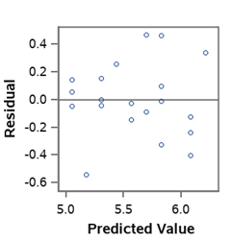
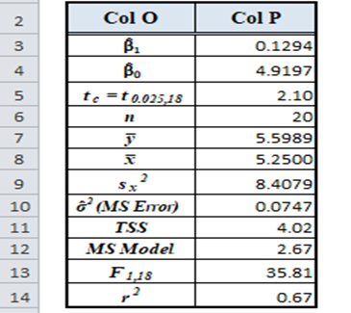
Residual Plots in More Detail - Residuals By Predicted Value
Check Normality Assumption
Check Homoskedasticity Assumption – Equal Variance

Slide 13
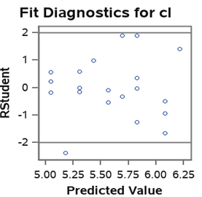
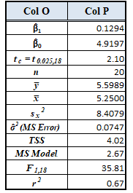
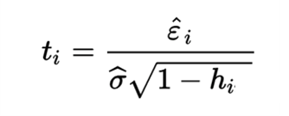
Residual Plots in More Detail Studentized Residuals By Predicted Value
A studentized residual t_{i}, is a residual divided by the model MSE multiplied by the square root of 1 minus the leverage.
Normally distributed data with t_{i} > 2 or < -2 may be flagged as an extreme values.
Checks Normality and Homoskedasticity (Equal Variance)

Slide 14
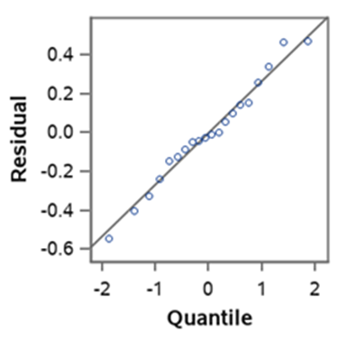
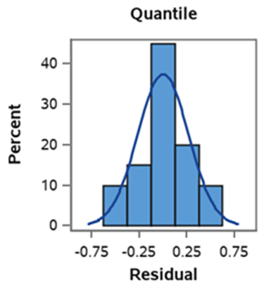
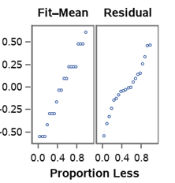
Residual Plots in More Detail - Evaluating Normality of Residuals
Look for obs. on line with more obs. in Middle.
Look for Normal Distribution Shape.
Look for S Curve with more obs. in Middle

Slide 15
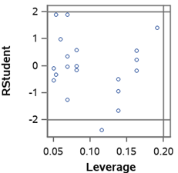
Residual Plots in More Detail -Leverage
Evaluates Observations contribution to variance
Ratio of variance for prediction to MSE
Observations with high leverage and a high residual may be problematic

Slide 16
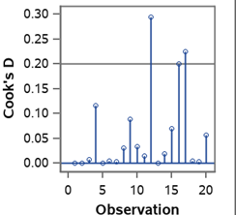
Residual Plots in More Detail - Cooks D
Evaluates Influential Observations.
Uses Studentized Residuals and Leverage.
Values greater than one certainly problematic.

Slide 17

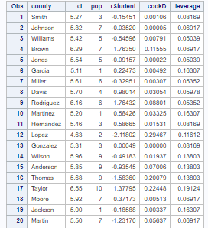
SAS Code to Get rStudent, cookD, and leverage by Observation

Slide 18
Exercise 1
Greenway Environmental Consultants Inc. are hired to evaluate if nitrogen (ug/l) in the soil around ponds in Smith County appear to affect algae (g) growth in the ponds. The company decides to do a pilot study and collect data on ten ponds to see if more research is feasible given the study results. It collects soil samples around each pond 50 feet apart and then averages them to measure nitrogen levels. The weight of a spoonful of algae from the center of the pond give algae measurements.
Using the data collected conduct the following analysis:
Run a regression analysis with all confidence intervals in SAS or R.
Analyze the residuals from the regression to check assumptions.
Manually confirm the F-statistic.
Interpret the F-statistic.
Manually confirm the t-statistics and their degrees of freedom.
Interpret the t-statistics.
Manually confirm the values of all confidence intervals.
Interpret all the confidence interval you calculated for the regression coefficients.
Find all confidence intervals for a pond with a nitrogen amount of 1.5.
What should the firm recommend about doing more research?

Slide 19
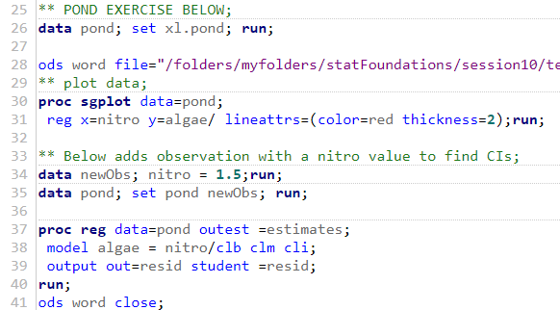
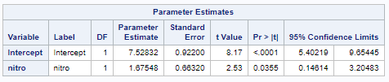
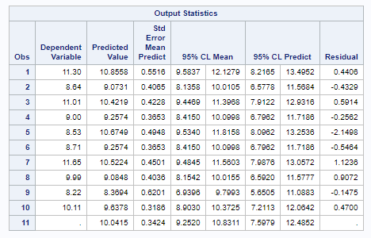
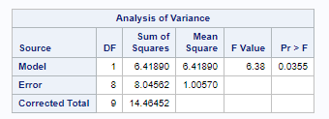
Exercise 1: Code and Model Output SAS

Slide 20
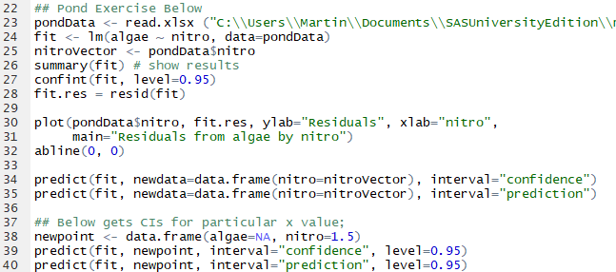
Exercise 1: Code and Model Output R

Slide 21
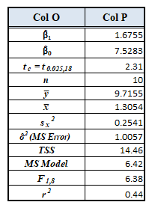
Exercise 1: Calculations Regression

Slide 22
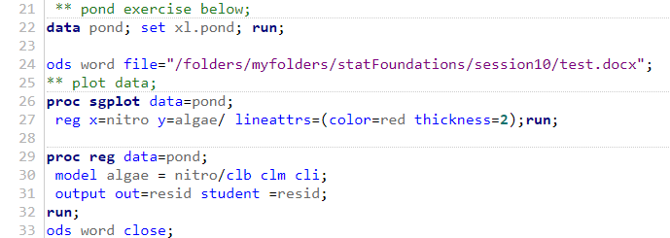
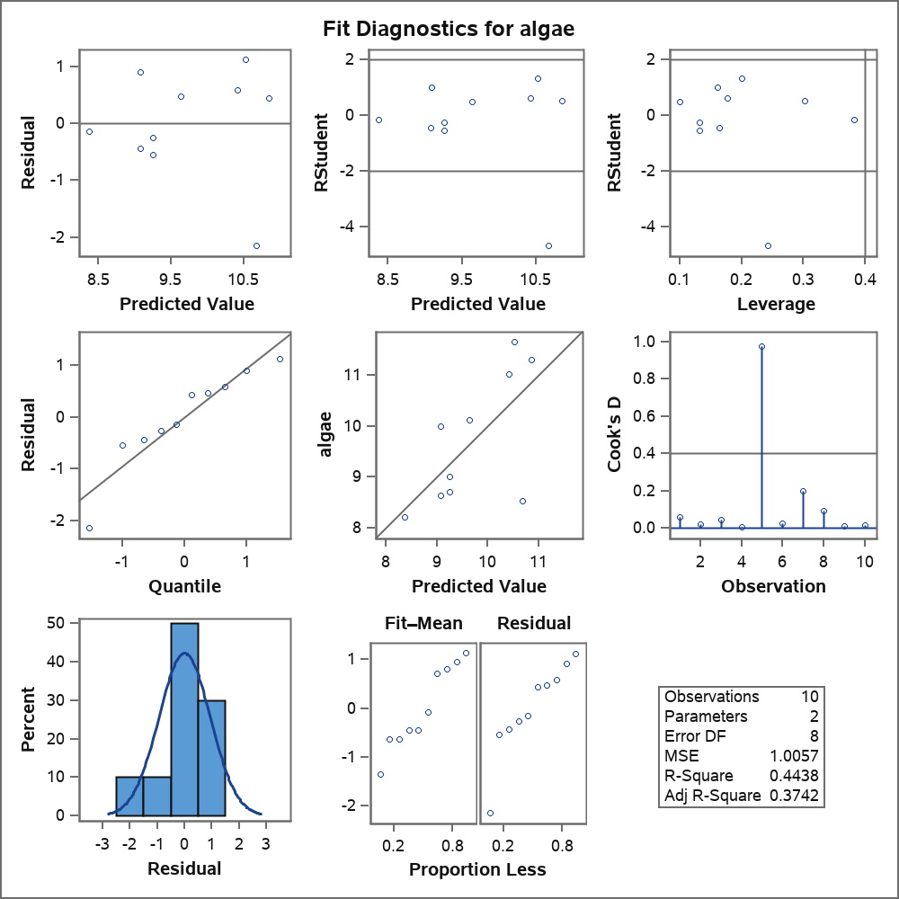
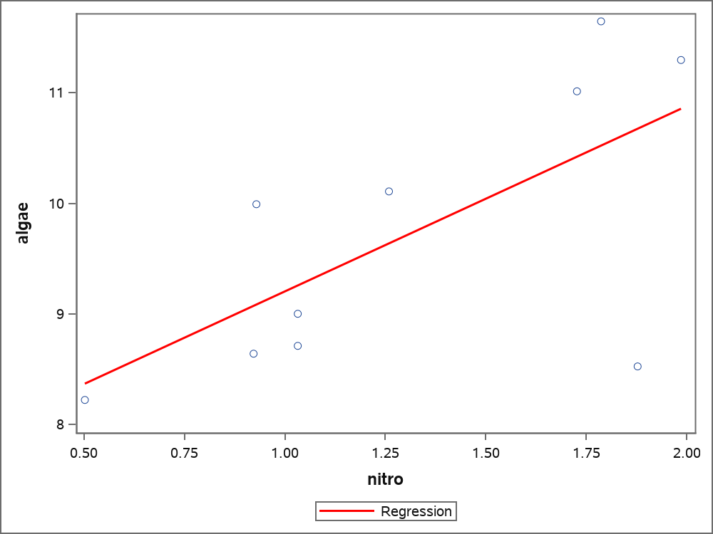
Exercise 1: Check Assumptions

Slide 23
Exercise 1: Answers
Using the data collected answer conduct the following analysis:
Run a regression analysis with all confidence intervals in SAS or R.
See Previous Slides.
Analyze the residuals from the regression to check assumptions.
Graph of nitro by algae appears linear, residuals appear normally
distributed with equal variance for error terms given nitro levels.
Manually confirm the F-statistic – See previous slide with calculations.
Interpret the F-statistic – Value is 6.38 which is significant with (18,1) d.f., so there is evidence the
slope is different from zero.
Manually confirm the t-statistics and their degrees of freedom - See previous slide.
Interpret the t-statistic prob(t) for β̂_{o} < 0.001 and prob(t) for β̂₁ = 0.0355
Both probabilities are < 0.05 so there is evidence all regression
coefficients are different from zero.
Manually confirm the values of all confidence intervals. -See previous slide.
Interpret all the confidence interval you calculated for the regression coefficients.
The mean intervals give confidence intervals for the mean of algae for nitrogen values. The
prediction interval gives confidence interval for an actual prediction of algae for nitrogen values.
Find all confidence intervals for a pond with a nitrogen amount of 1.5.
Mean (9.3,10.8) Predict(7.6,12.5)
What should the firm recommend about doing more research?
Since the regression results provide evidence that algae levels are linearly correlated with
nitrogen, more research is feasible.

